Slide 1
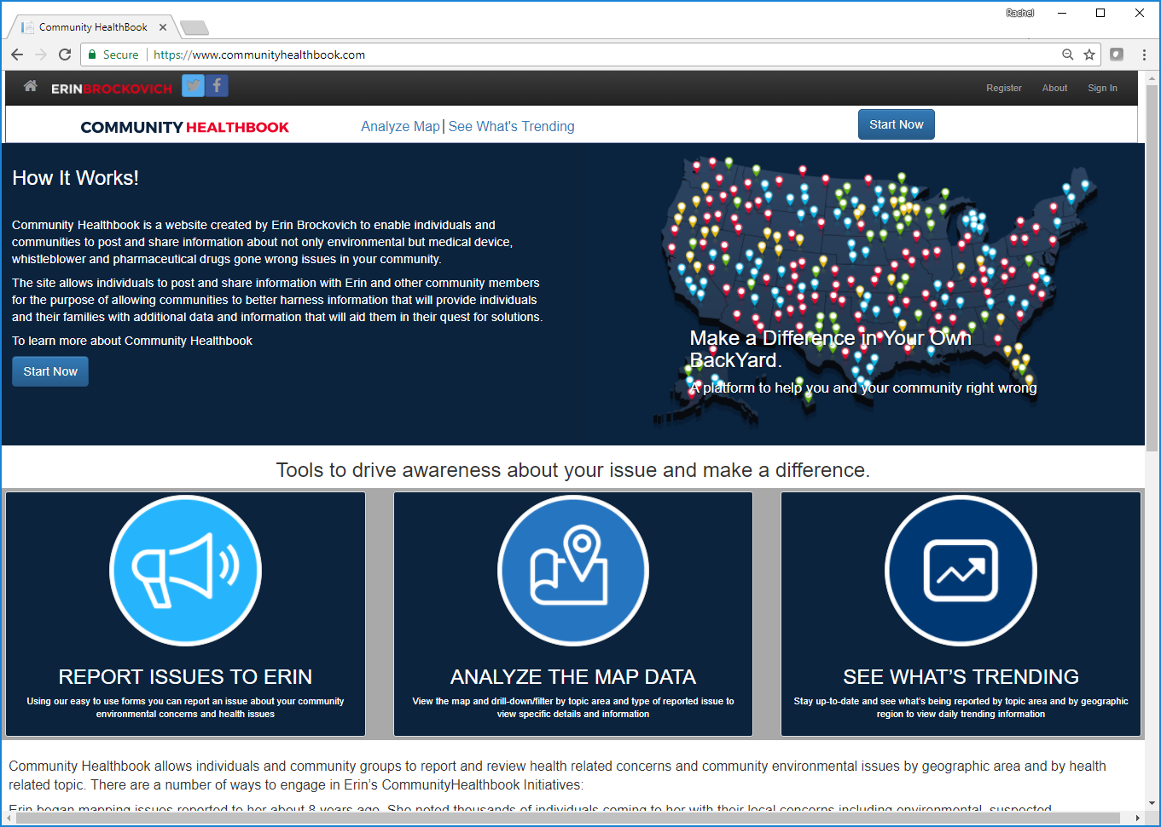
COMMUNITY HEALTHBOOK HOMEPAGE

Slide 2
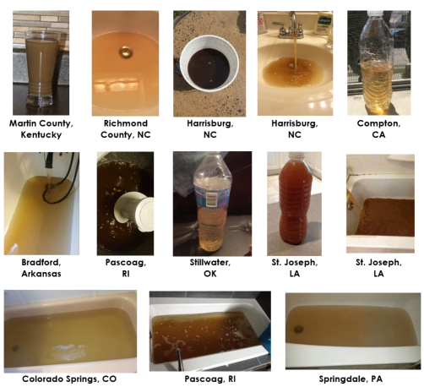
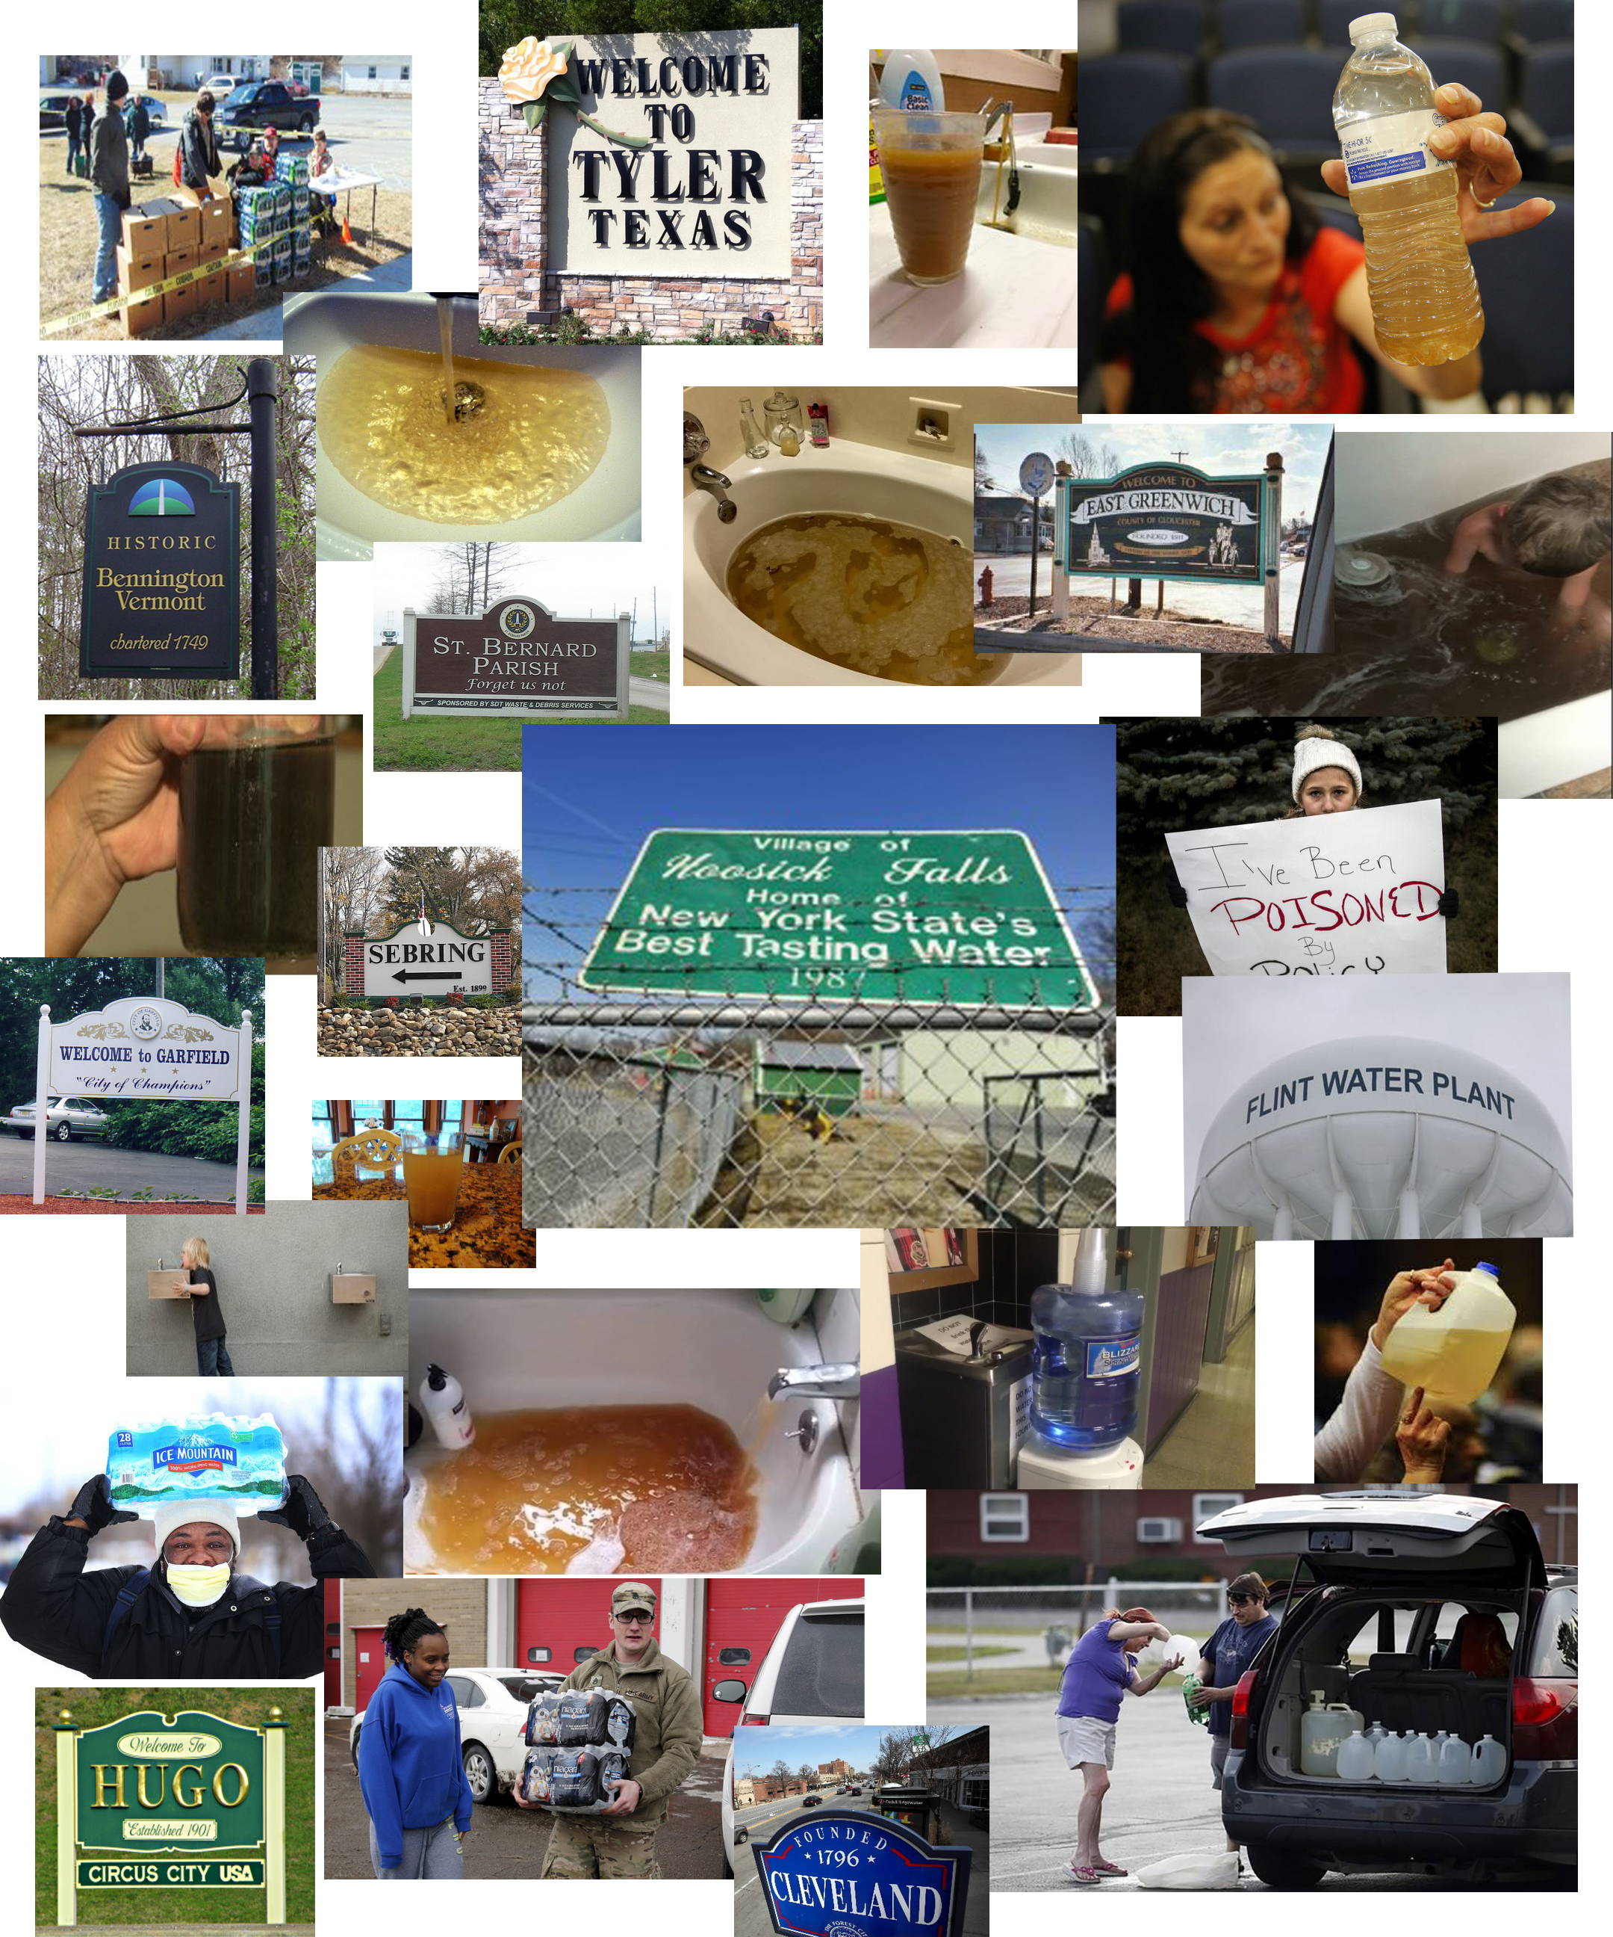
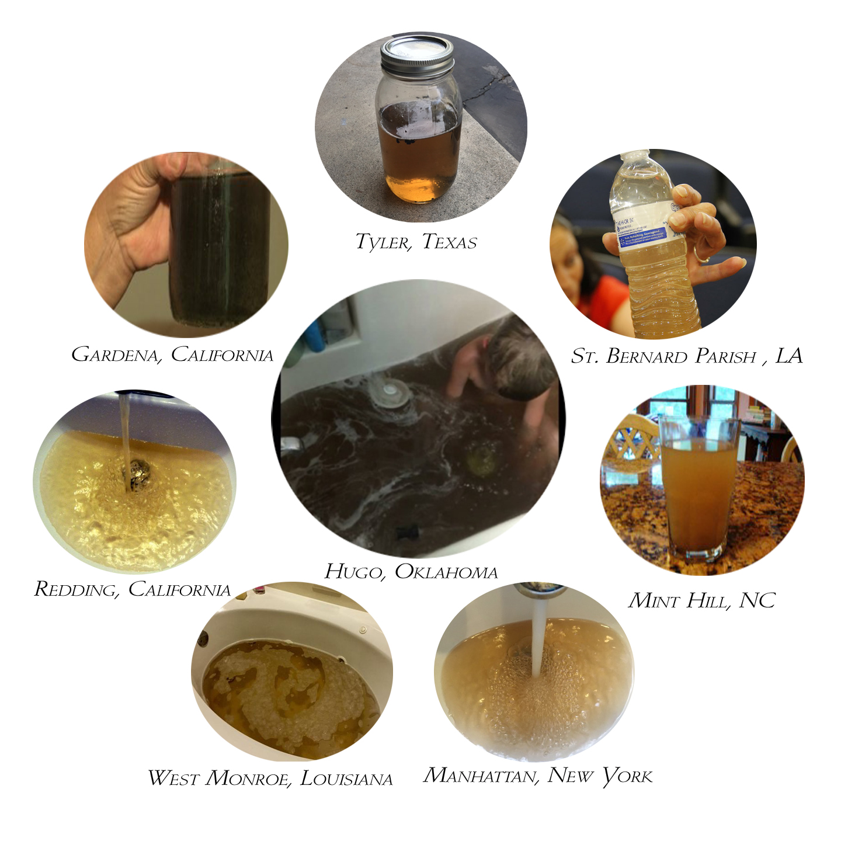
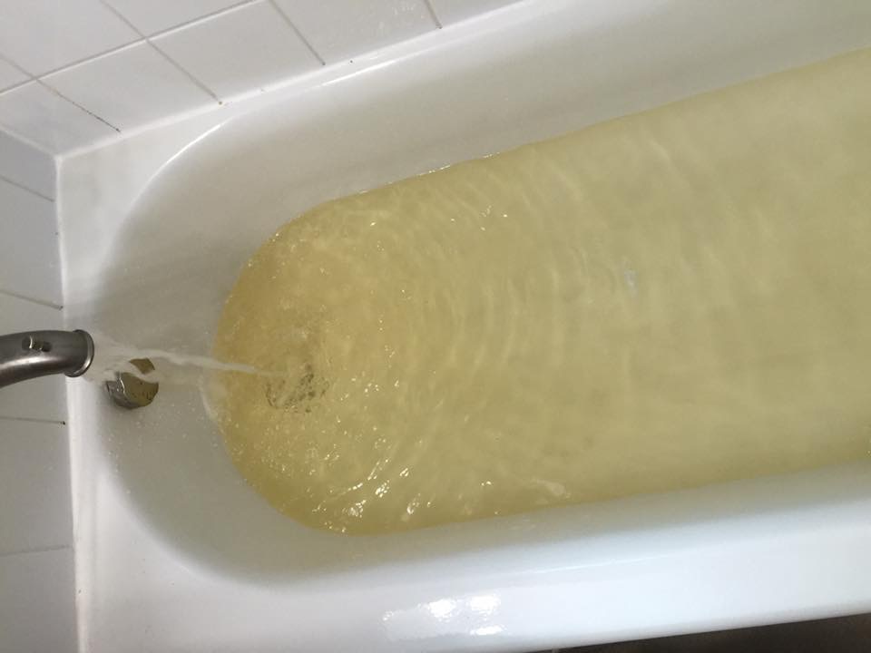
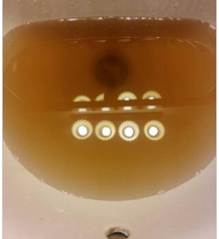
THIS IS WHAT PEOPLE REPORT TO ME EVERYDAY
Notes:
Individuals reporting have done a lot of their own research
They have netted out a lot of information

Slide 3
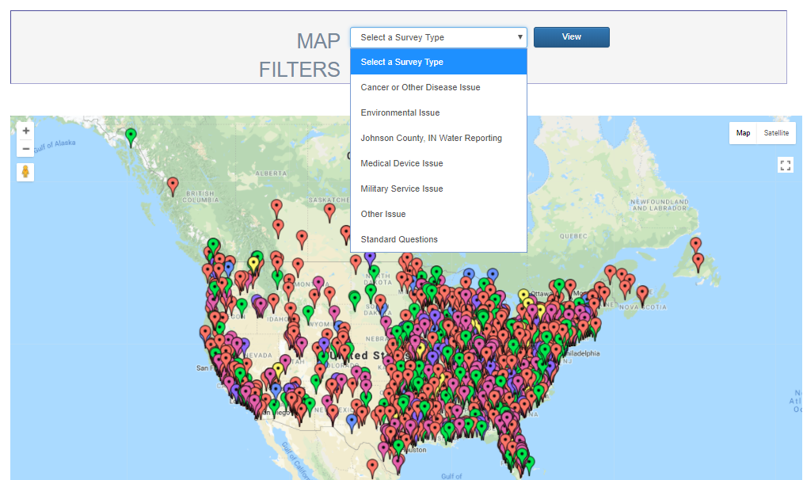
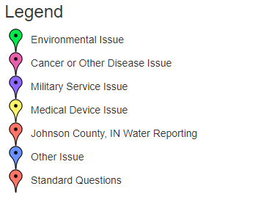
PUBLIC COMMUNITY MAP VIEW
Notes:
Public Community MAP View

Slide 4
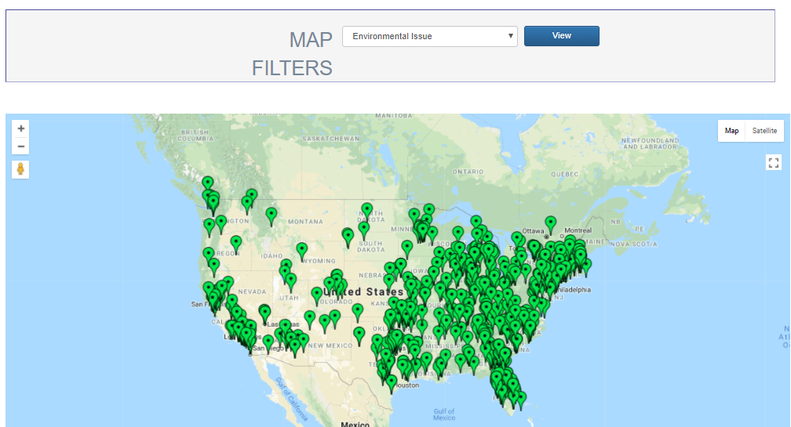
PUBLIC COMMUNITY MAP VIEW – ENVIRONMENTAL ISSUES
Notes:
Public Community MAP View

Slide 5
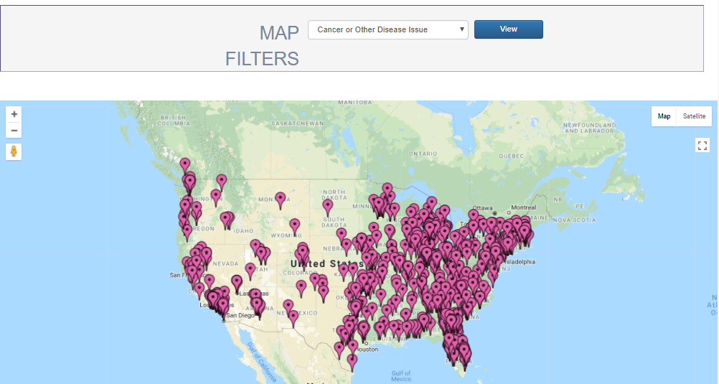
PUBLIC COMMUNITY MAP VIEW – CANCER OR OTHER DISEASE
Notes:
Public Community MAP View

Slide 6
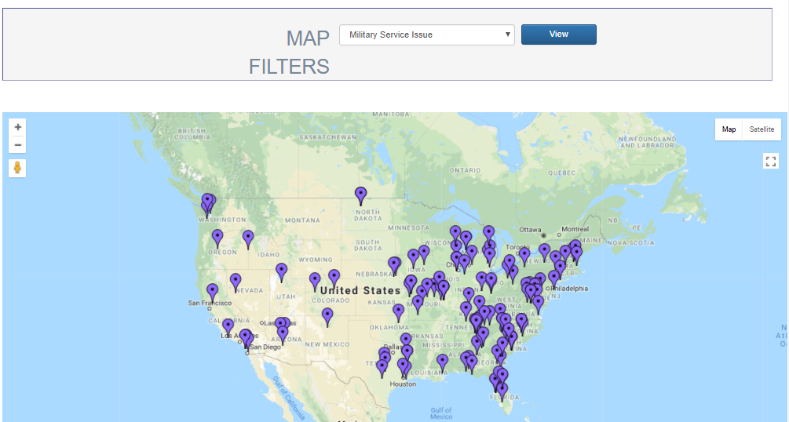
PUBLIC COMMUNITY MAP VIEW – MILITARY SERVICE ISSUES
Notes:
Public Community MAP View

Slide 7
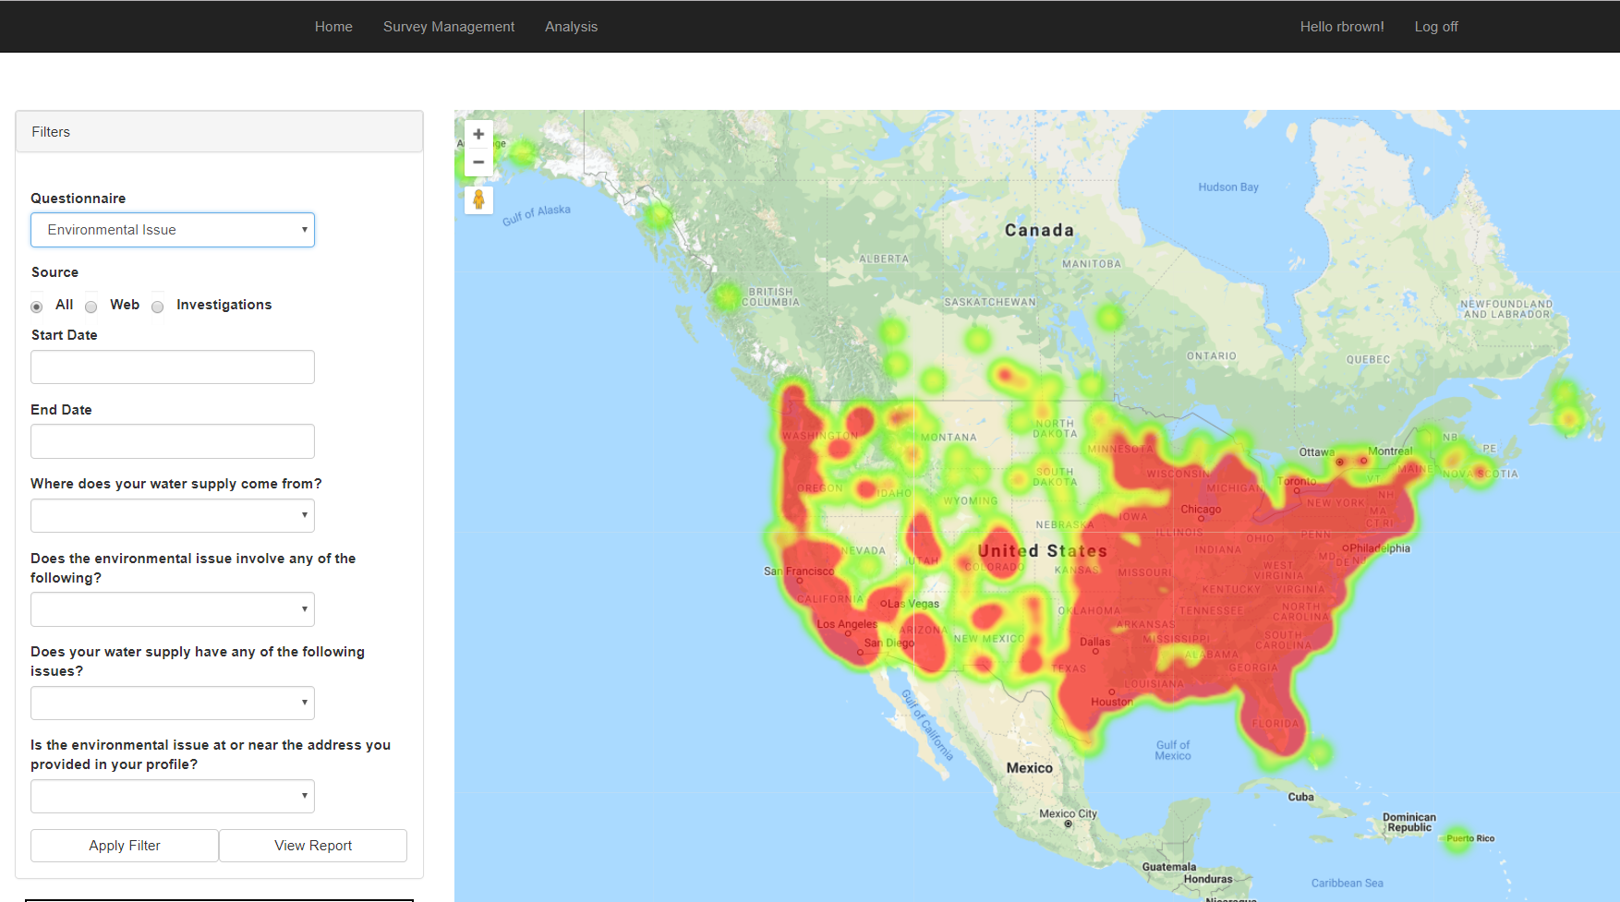
HEAT MAP
A representation of data in the form of a map in which data values are represented as colors.
Notes:
Heat Map

Slide 8
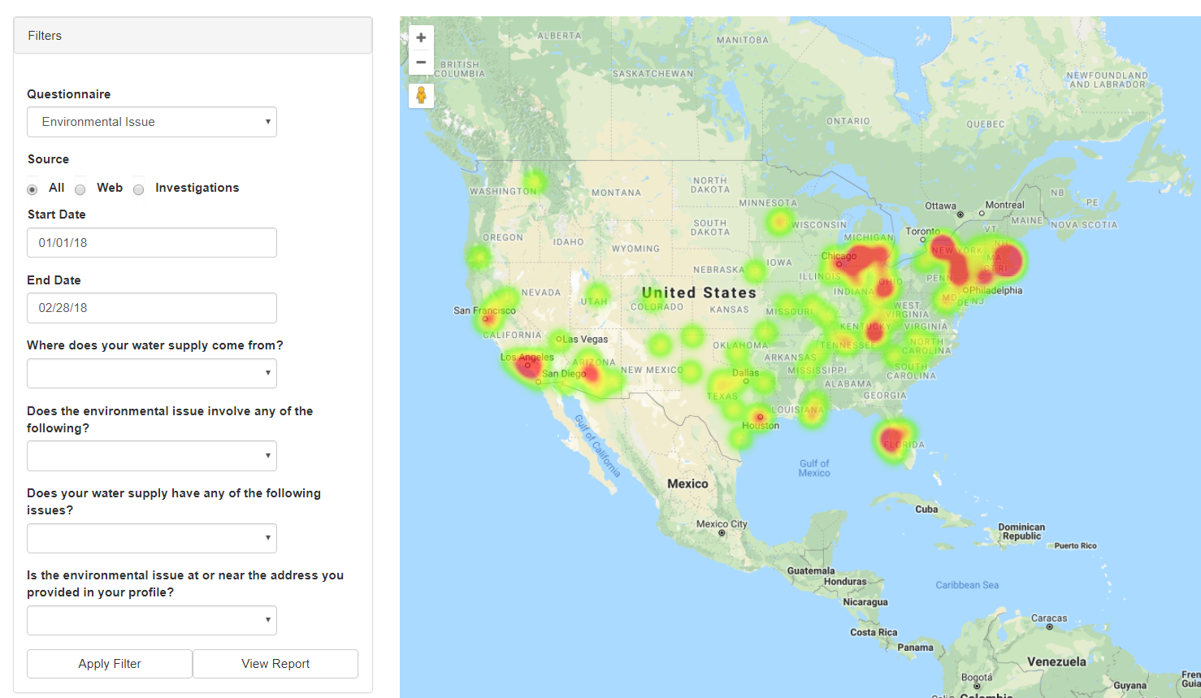
HEAT MAP (WITH FILTERING)
Filter by question type (e.g. Environmental Issue)
Dates (e.g. All Environmental Issues in January and February 2018
Notes:
Further filtering of a Heat Map

Slide 9
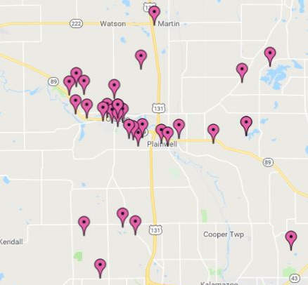
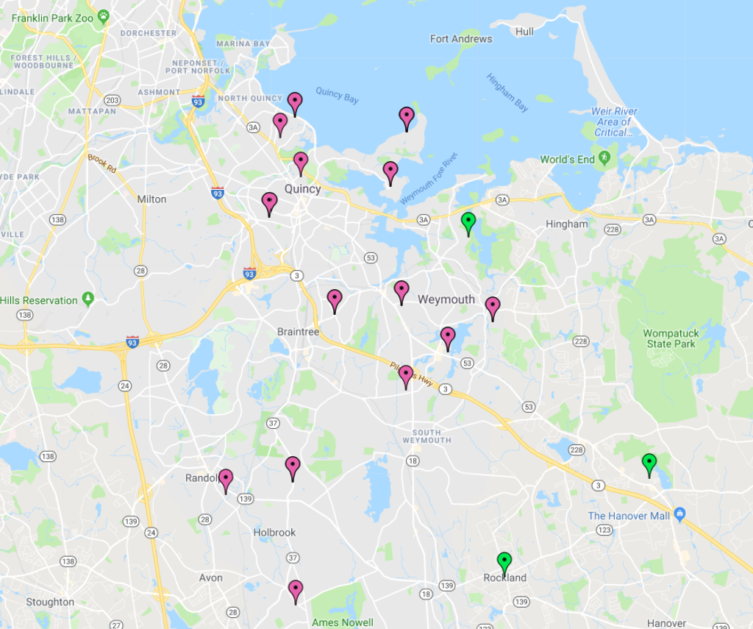
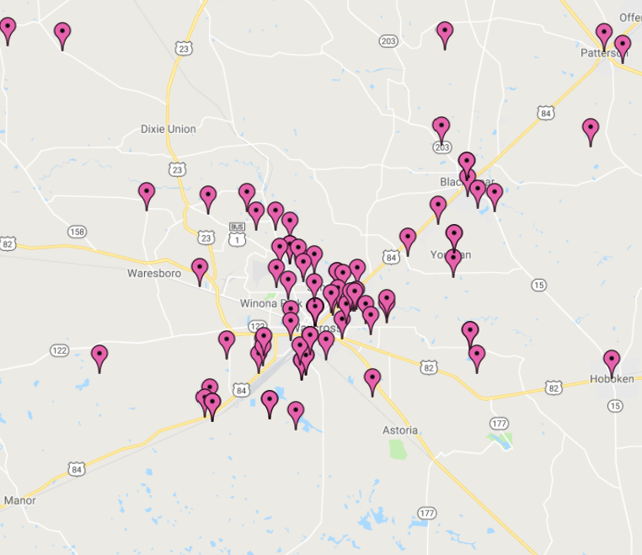
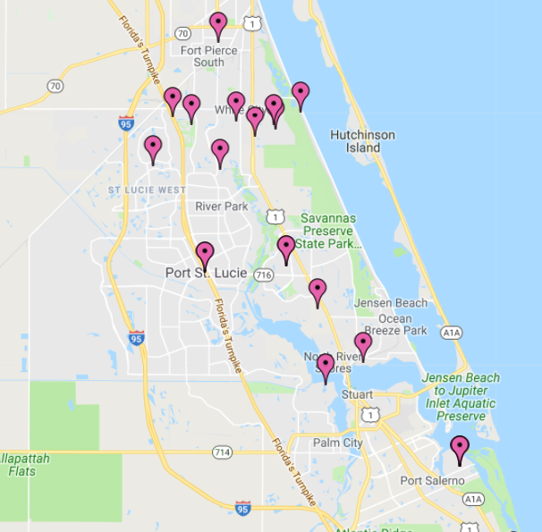
CLUSTER MAP
Cluster analysis to identify the locations of statistically significant hot spots, cold spots, spatial outliers and similar situations.
Quincy, MA
48 reports
P&G factory
Various cancers, high number of lung cancer
Otsego, MI
68 reports
602 reports Alamo Health Survey
Paper mills on river
Johnson County, IN
105 Reports
Childhood cancers
Contaminated water
Waycross, GA
144 reports
CSX
High number of childhood cancers
Port St. Lucie, FL
40 reports
Nuclear power plant
Glioblastoma cluster
Notes:
Cluster Map (counts)

Slide 10
CONTACTS FOR ADDITIONAL INFORMATION
Community Healthbook
www.communityhealthbook.com
www.Brockovich.com
Erin Brockovich
Erin@Brockovich.com
CHB Data Services and MIP™ Application Information
chbinfo@macksonconsulting.com

