Slide 1
by Ashton Applewhite thischairrocks.com | @thischairrocks | yoisthisageist.com oldschool.info
We Are All Aging Let’s End Ageism

Slide 2
OLD

Slide 3
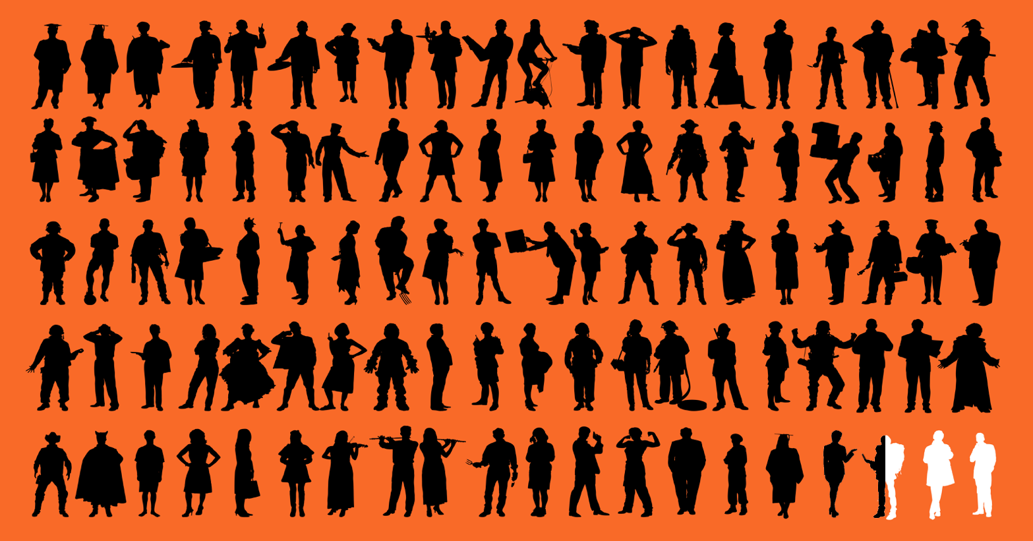
Most of us won’t live in nursing homes.
2.5% of the 65+
population

Slide 4
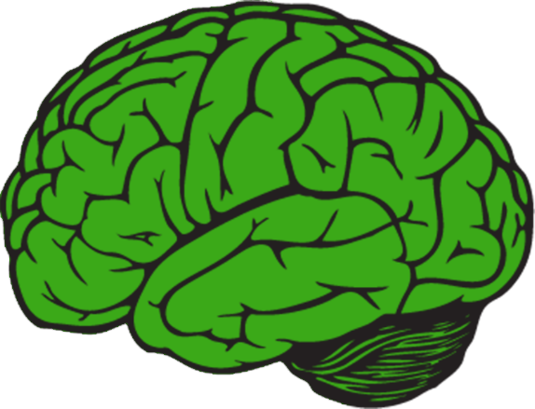
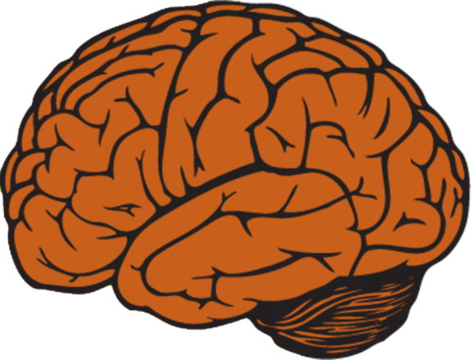
8 out of 9 brains will hang in just fine.

Slide 5
Most of us will be happier.
Childhood
Old Age
Middle Age

Slide 6
The more you know about
growing older, the better it looks.

Slide 7
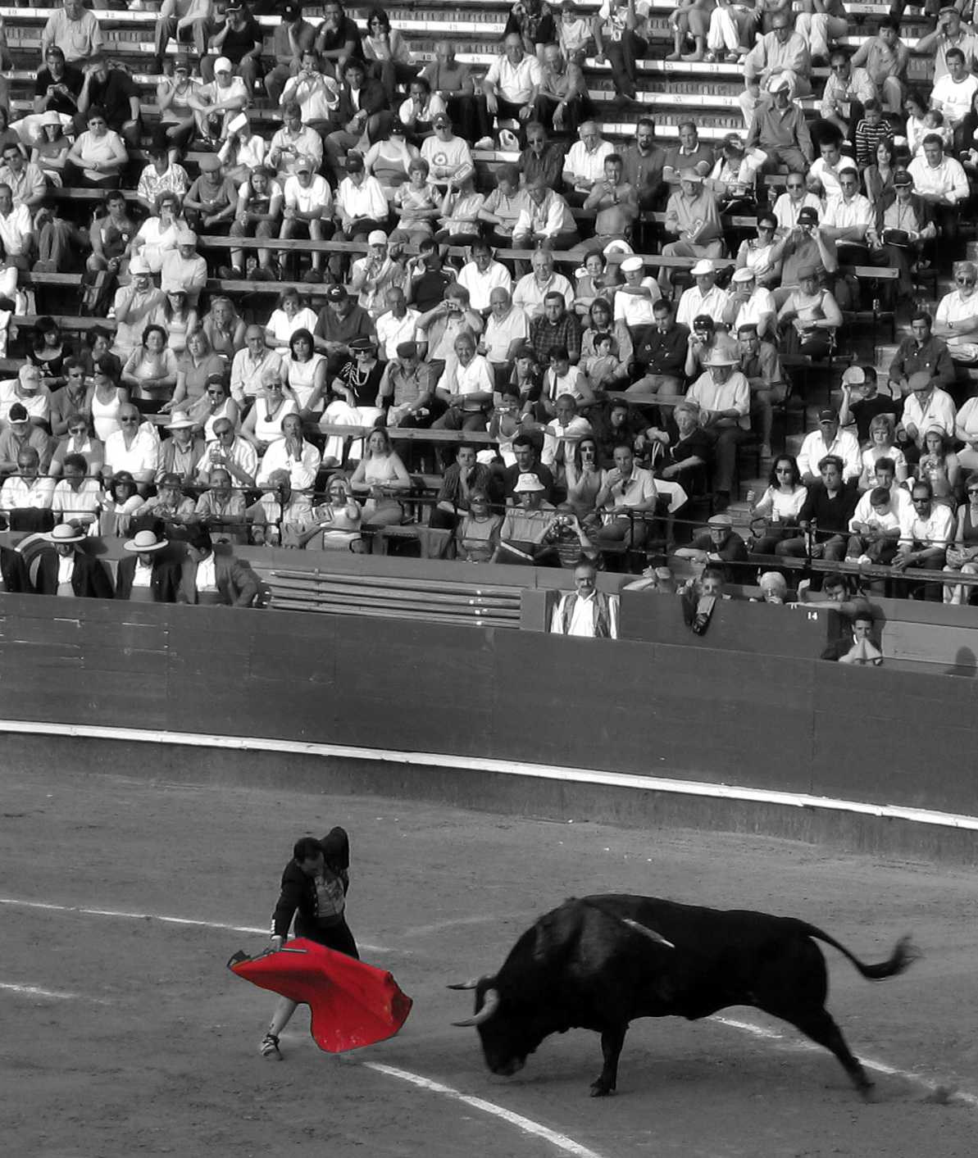
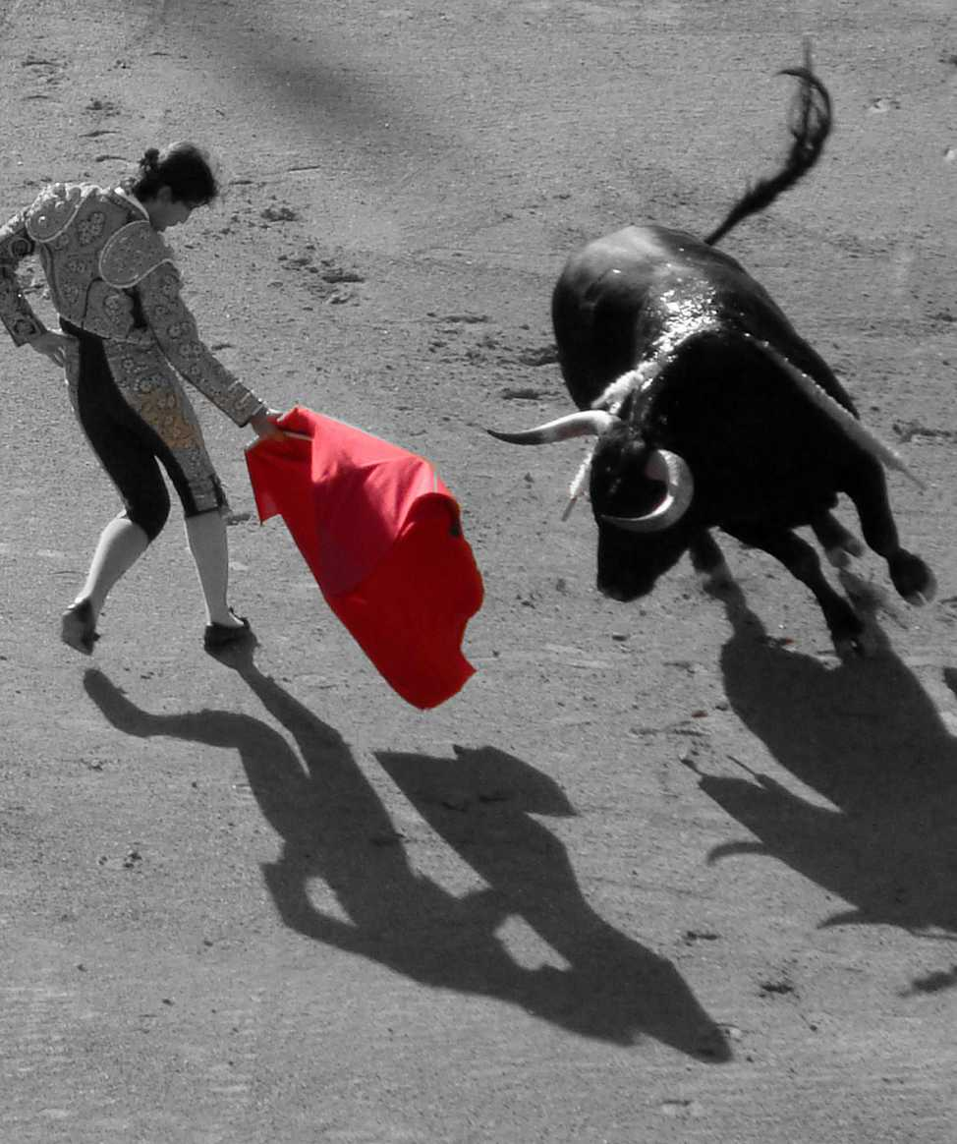
The bull looks different.
The bull looks different.

Slide 8
Ageism:
discrimination and stereotyping
on the basis of age

Slide 9
Prejudice isn’t about biology. It’s about power.

Slide 10
RACISM
HOMOPHOBIA
Prejudice pits us
against each other.
NATIONALISM
ABLEISM
SEXISM

Slide 11
We are all ageist.

Slide 12
Unlearning is hard, especially when it comes to values.

Slide 13
Ageism is prejudice against our own
future selves.
© Rebeca Mendez

Slide 14
Discrimination is the problem.
Not aging.

Slide 15
Ageism cuts
work lives short.

Slide 16
Ageism harms our health.
@myriamzilles on Unsplash

Slide 17
Ageist myths and stereotypes
affect cognition.

Slide 18
AGEISM
Ageism disproportionately
affects women.
SEXISM

Slide 19
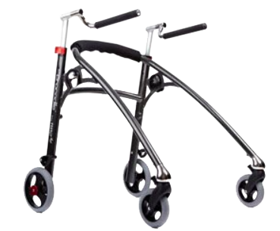
Ageism feeds ableism (prejudice against people with disabilities), and vice versa.

Slide 20
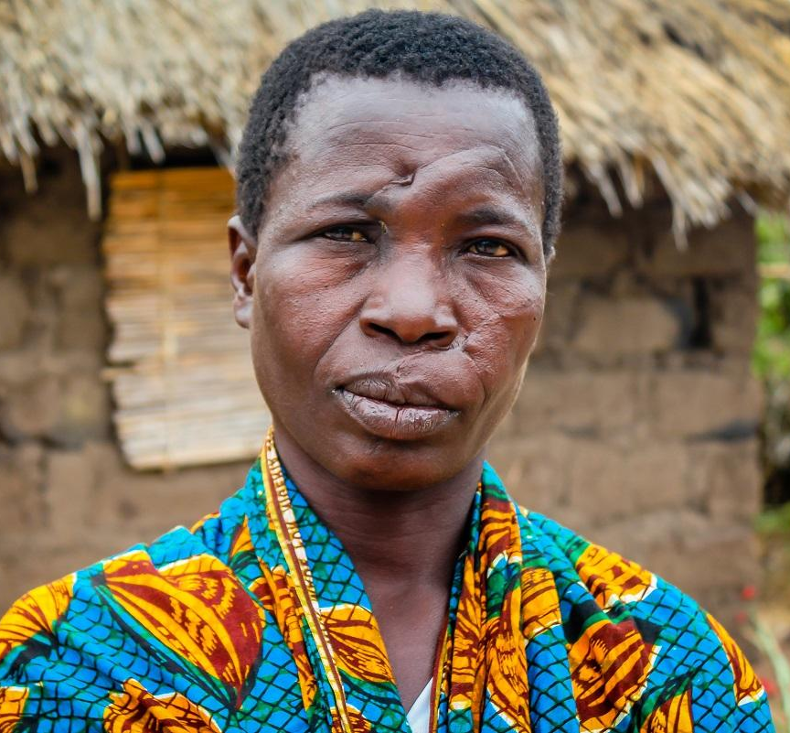
Ageism
legitimizes
abuse.
© Judith Escribano/Age International

Slide 21
Ageism makes it harder to make
good end-of-life decisions.

Slide 22
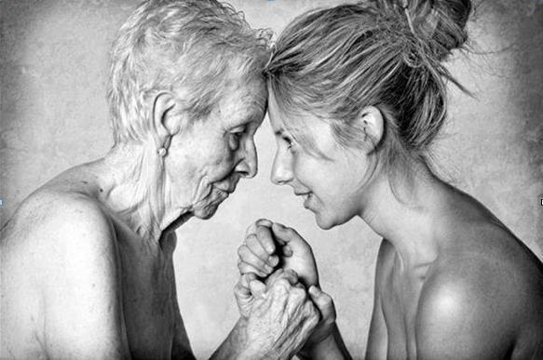
Ageism segregates us.

Slide 23
We have an
extraordinary opportunity.

Slide 24
How do we get there?
Tap into what we know: aging enriches us.
Look more generously at each other, and at ourselves.
Ask for help.
Make friends of all ages.
Join forces.

Slide 25
About - a small but mighty grassroots organization created to raise awareness of ageism and how to undo it
Projects - a place to find and support anti-ageist initiatives
Learn - the place to find all the best resources about ageism
Events - a calendar of free, pro-age events
Plus merch, testimonials, where to find us, and how to hire and donate to the Old School Hub

Slide 26
Dismantling ageism
means supporting every
struggle for equal rights.

Slide 27
The movement to end ageism
must represent us all.

